Slide 1
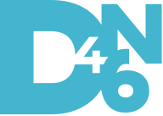
DIGITAL FORENSICS TRENDS 2020
PresENted BY: VIRAJ RATHOD (D4N6 INTERN)
PRESENTED TO: MR. AMRIT CHHETRI (D4N6 MENTOR)

Slide 2
What is Digital Forensics?
Digital forensics (sometimes known as digital forensic science) is a branch of forensic science encompassing the recovery and investigation of material found in digital devices, often in relation to computer crime.
It can be defined as the process of preservation, identification, extraction, and documentation of computer evidence which can be used by the court of law. It is a science of finding evidence from digital media like a computer, mobile phone, server, or network. It provides the forensic team with the best techniques and tools to solve complicated digital-related cases.
Digital Forensics helps the forensic team to analyzes, inspect, identifies, and preserve the digital evidence residing on various types of electronic devices.

Slide 3
Ransomware Attacks
Ransomware is a malicious software and type of malware, which denies access to data, network, or computer system and asks for a ransom to be paid. The common ways of spreading ransomware are through phishing emails & links.
There has been a rapid increase in ransomware attack these days.
Some of the most massive ransomware attacks in the last 5 years are:
TeslaCrypt
SimpleLocker
WannaCry
SamSam
CryptoLocker
Cerber
Petya und NotPetya

Slide 4
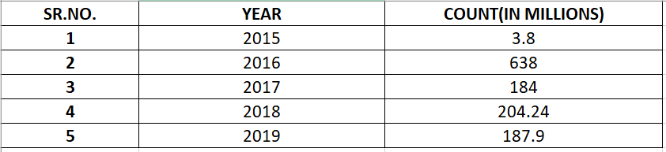
DATA SHOWING RANSOMWARE COUNT/YEAR FOR 5 YEARS

Slide 5
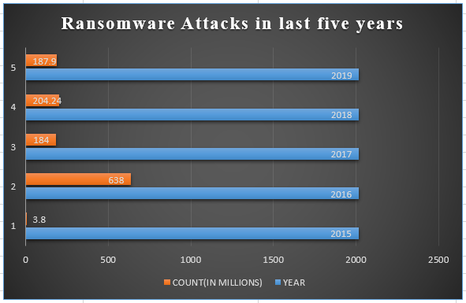
B
A
R
C
H
A
R
T

Slide 6
Ransomware can be avoided by following the below points.
Keep your software and operating system updated because an outdated system and operating method are the reason for various attacks.
Train your employees not to open or click on links that are from unsolicited emails.
Keep a backup of your data regularly and also have offline storage of the data.
To run a program on a network use application whitelisting to approve them.
To prevent a network from cyber attack, phishing emails, and messages, it is vital to apply active filters.
All incoming and outgoing emails should be scanned to detect threats.
Access to a malicious IP address can be blocked through firewalls.

Slide 7
THANK YOU..!!

